Slide 1

Introduction to Machine Learning
KamiLimu Data Science Track
Slides by Mbithe Nzomo
Computer Science PhD Candidate
University of Cape Town

Slide 2
Agenda
Overview of Machine Learning
What is ML
Types of ML
Supervised Learning
Regression
Classification
ML Algorithms
Model Selection
Linear Regression
Logistic Regression
k-Nearest Neighbours
Homework

Slide 3

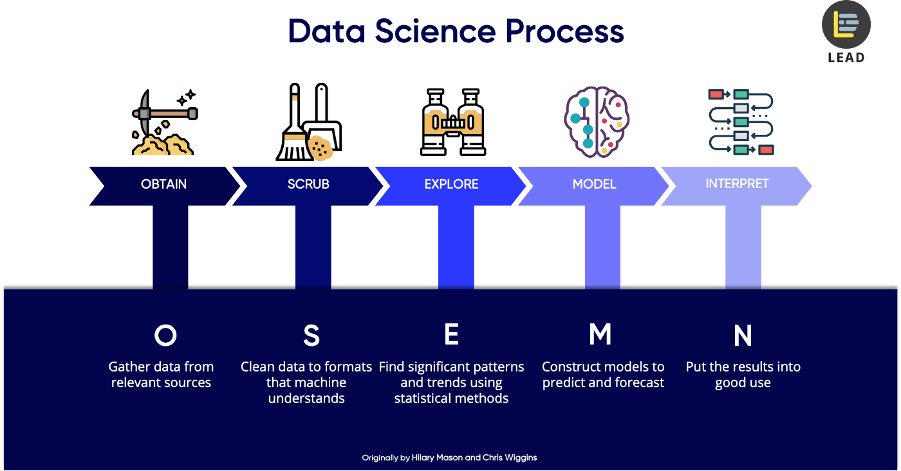
The Data Science Process
PROBLEM
OBTAIN
PREP
EXPLORE
MODEL
P
O
P
E
M
Define goal +
Project charter
Gather data from relevant sources
Clean + format data
Transform, visualise, hypothesise
Build a model
Fit the model
Validate the model

Slide 4

Overview of Machine Learning

Slide 5
Machine Learning is…
the science of teaching computers to learn from data

Slide 6
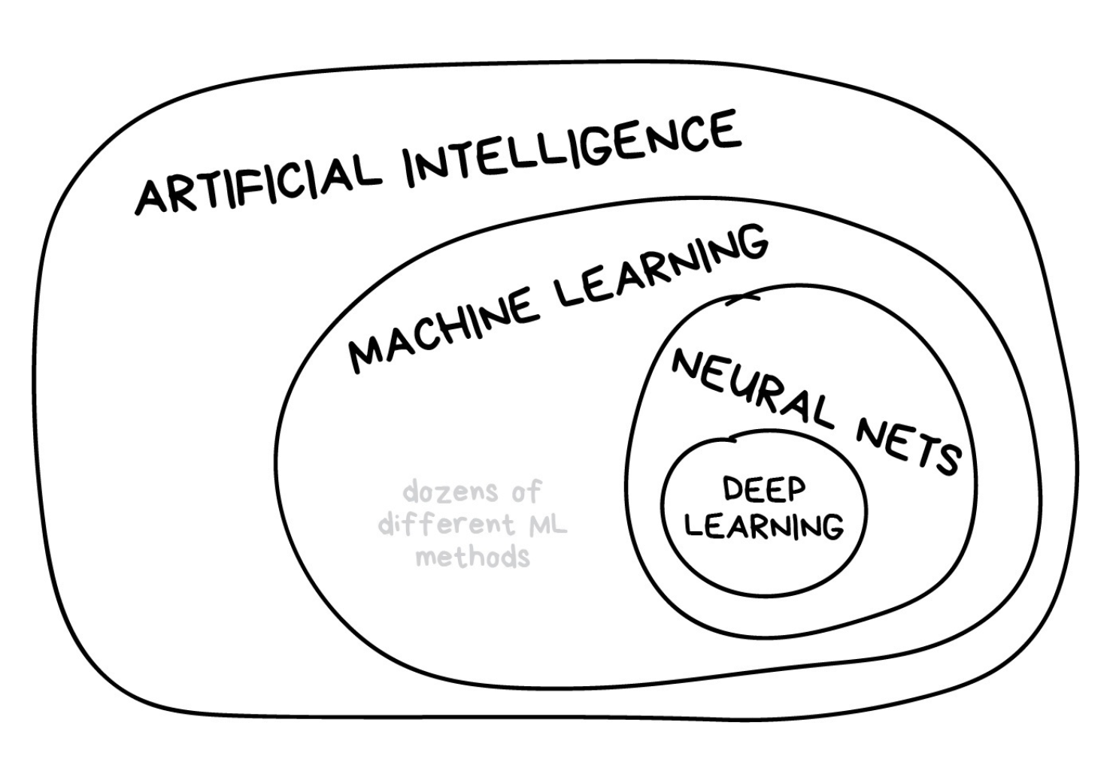
Machine Learning is…

Slide 7
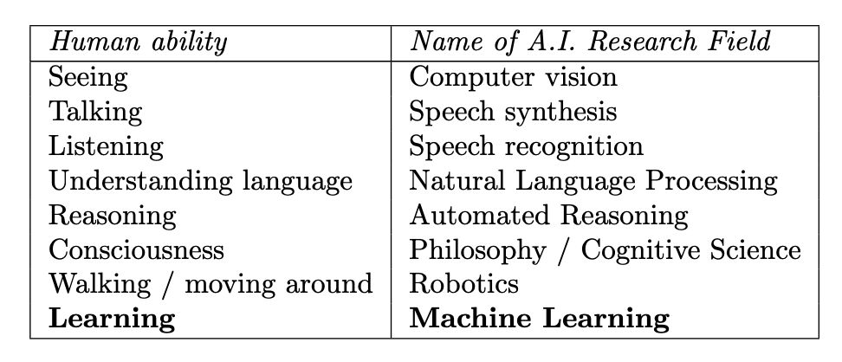
Machine Learning is…

Slide 8
Machine Learning is…

Slide 9
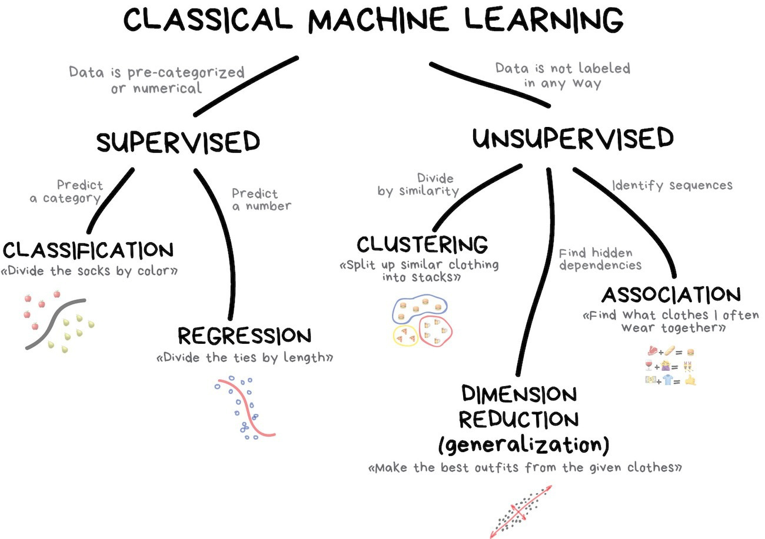
c
c

Slide 10
Methods that attempt to explain how an observed outcome is related to a set of potential predictor variables
Predict a categorical variable
Predict a numerical variable
c

Slide 11
Regression: A numerical outcome such as stock returns or number of sales
Predict a categorical variable
Predict a numerical variable
c

Slide 12
Classification: A categorical outcome such as profit or loss, cat or dog, etc.
Predict a categorical variable
Predict a numerical variable
c

Slide 13
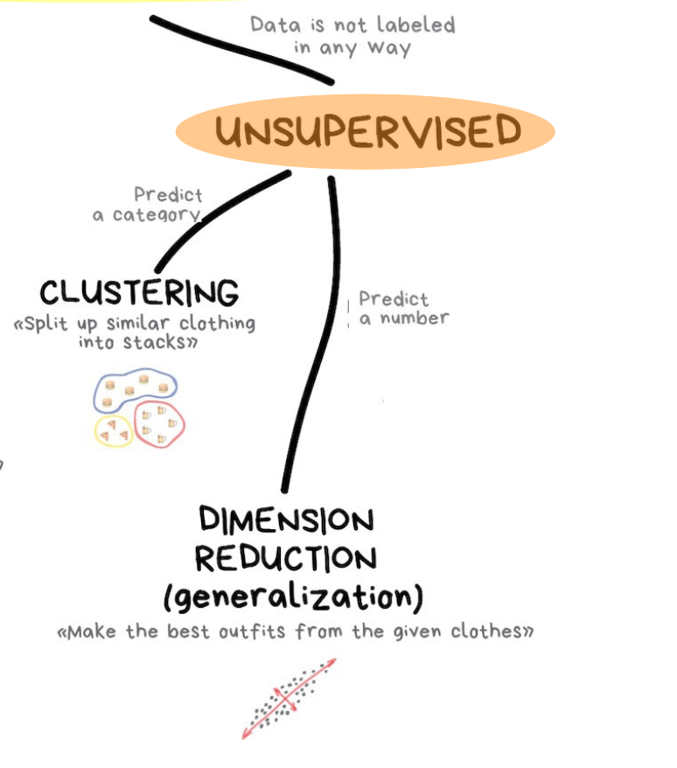
Methods to identify patterns and structure in the data without an outcome variable
Group observations
Reduce variables

Slide 14
Data is not labelled, so there's no “supervisor” to guide the learning process
Group observations
Reduce variables

Slide 15
Clustering: Identify latent/unobserved groupings of the rows/observations
Group observations
Reduce variables

Slide 16
Dimension reduction: Reduce the number of columns/variables
Group observations
Reduce variables

Slide 17
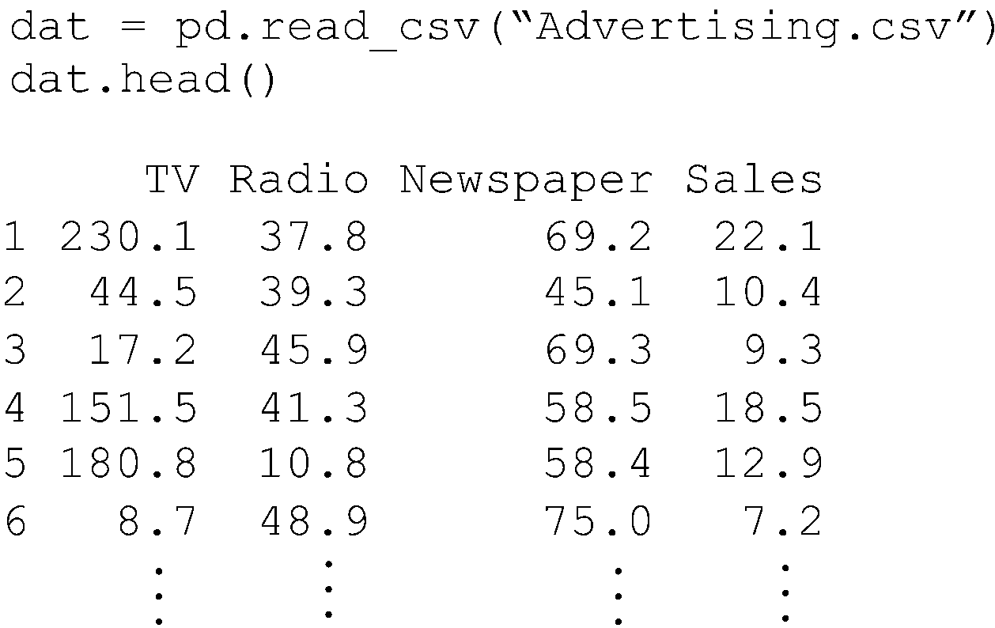
Example: Regression
Given a dataset containing sales and expenditure on TV, radio, and newspaper advertising for 200 companies, can we predict sales based on advertising expenditure?

Slide 18
Example: Classification
Given a dataset containing percentages of words and punctuation marks appearing in 4,601 emails marked as spam or not spam, can we predict whether an incoming email is spam?
type free your our mail order $ ! (
email 0.000 0.000 0.270 0.550 0.000 0.000 0.000 0.549
email 0.000 1.780 0.890 0.000 0.000 0.000 0.000 0.298
email 0.000 0.000 0.000 1.960 0.000 0.000 0.000 0.373
email 0.000 0.000 0.000 0.000 0.000 0.000 0.000 0.000
email 0.000 0.000 0.600 0.000 0.100 0.000 0.000 0.049
spam 0.000 2.830 0.940 0.940 0.000 0.000 0.000 0.000
spam 1.050 2.100 0.000 0.000 0.000 0.182 0.365 0.365
email 1.380 1.380 0.000 0.690 0.000 0.000 2.378 0.000
email 0.000 0.000 0.000 0.000 0.000 0.000 0.000 0.098
email 0.930 0.000 0.000 0.000 0.000 0.000 0.000 0.163

Slide 19
Example: Clustering
Given a dataset containing of demographic variables for Kenyan counties, can we identify distinct groups of counties for targeted marketing?
County Income Age Persons Births Employ Urban Educ
01 20 26 64 55 31 22 89
02 18 29 34 43 29 22 87
03 33 29 226 66 37 23 108
04 24 31 91 74 15 20 106
05 22 26 68 55 32 24 88
06 20 28 76 45 27 22 85
07 21 25 72 63 17 25 86
08 30 29 314 73 25 20 10
09 16 24 46 38 31 24 86
10 26 32 63 67 28 21 93

Slide 20
Example: Clustering
Given a dataset containing of demographic variables for Kenyan counties, can we identify distinct groups of counties for targeted marketing?
County Income Age Persons Births Employ Urban Educ
01 20 26 64 55 31 22 89
02 18 29 34 43 29 22 87
03 33 29 226 66 37 23 71
04 24 31 91 74 15 20 55
05 22 26 68 55 32 24 88
06 20 28 76 45 27 22 85
07 21 25 72 63 17 25 86
08 30 29 314 73 25 20 10
09 16 24 46 38 31 24 86
10 26 32 63 67 28 21 93

Slide 21
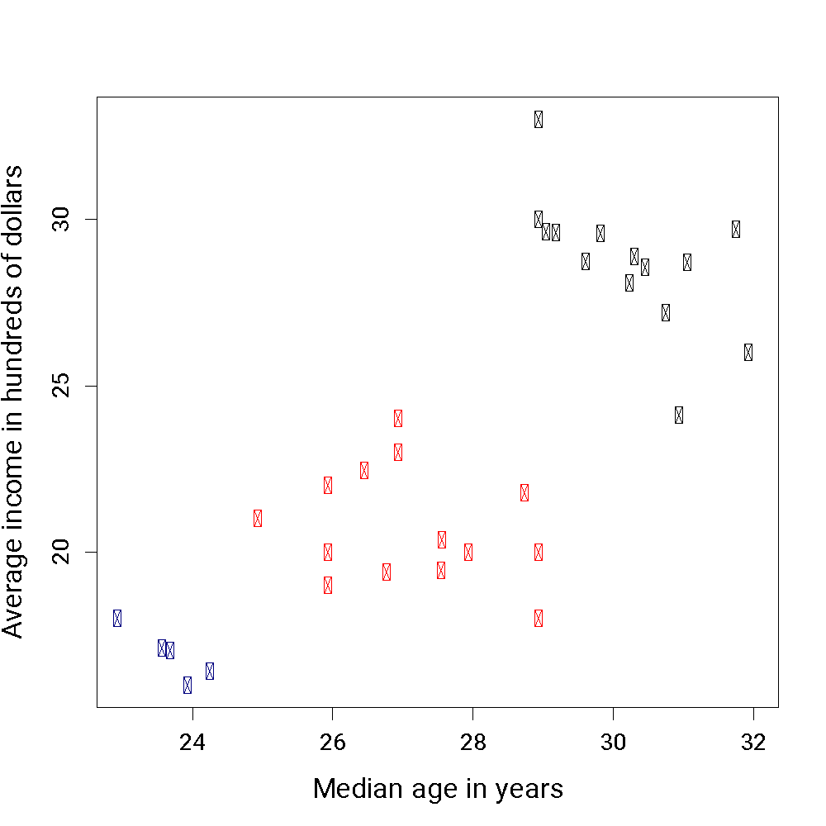
Example: Clustering
Median monthly income in 000s of shillings
Median age in years

Slide 22
Example: Dimensionality Reduction
Given a dataset comprising variables associated with cancer, can we reduce the number of variables by constructing new ones that “summarize” the original variables?
BRCA1 | BRCA2 | p53 | Sun exposure | Smoker status | Weight
-0.46 | -0.26 | -0.05 | 61 | 1 | 55
-0.91 | -0.99 | -0.82 | 90 | 0 | 65
0.95 | -0.39 | -0.43 | 84 | 1 | 78
-0.34 | 0.95 | -0.71 | 43 | 1 | 120
-0.48 | -0.86 | 0.12 | 95 | 0 | 69
0.59 | -0.65 | -0.96 | 67 | 1 | 74
0.66 | -0.46 | 0.22 | 55 | 1 | 96
0.20 | 0.54 | 0.04 | 13 | 1 | 51
-0.79 | 0.11 | 0.36 | 84 | 0 | 82
Genetics | Lifestyle
-0.26 | 68
-0.91 | 78
0.04 | 91
-0.03 | 92
-0.41 | 82
-0.34 | 80
0.14 | 86
0.26 | 42
-0.11 | 83

Slide 23

Your turn! An interactive exercise
See if you can decide which machine learning approach is most appropriate for each of the following examples…

Slide 24

Example 1
A secondary school wants to understand which students are likely to do well on the Kenya Certificate of Secondary Education (KCSE) Mathematics exam.
We have the KSCE scores and several academic, demographic, and social variables for students who wrote the exam over the past 5 years.

Slide 25

Example 2
A bank needs to decide whether to lend money to new clients. They have a database of past client information, including whether or not each client defaulted on their payments.

Slide 26

Example 3
An online store wants to identify irregular user behavior on their website. They have collected a large amount of information on user interactions.

Slide 27

Example 4
You wish to categorize Wikipedia pages into broad topics (science, history, politics, etc) by analyzing the words used in each document.

Slide 28
Agenda
Overview of Machine Learning
What is ML
Types of ML
Supervised Learning
Regression
Classification
ML Algorithms
Model Selection
Linear Regression
Logistic Regression
k-Nearest Neighbours
Homework

Slide 29

Supervised Learning

Slide 30
Regression vs Classification
Variables can be characterised as either quantitative (numerical) or categorical
Supervised learning methods with a quantitative outcome (such as sales) are often referred to as regression methods
In contrast, if the outcome is categorical (such as email type), it is commonly referred to as a classification task

Slide 31
Recall this example

Slide 32
Definitions and notations
The variable to be predicted (i.e. number of sales) is referred to as the target, outcome, output, or dependent variable
The actual (true) value is denoted by the letter y
The predicted value is denoted as ŷ (pronounced y-hat)

Slide 33
Definitions and notations
The other variables (i.e. TV, radio, and newspaper expenditures) are referred to as features, inputs, or independent variables
They are denoted as X₁, X₂, X₃ ... X_{n}
Collectively, they are represented as columns in a matrix X

Slide 34
Definitions and notations
Each row in the database is referred to as an example or an observation

Slide 35
Basic concepts: Regression
Consider a regression problem where y is income and X is years of education
We assume that the value of the outcome variable for a specific observation can be written as:
y = [ave. y given X] + ε
Notes:
Ε = epsilon

Slide 36
Basic concepts: Regression
Imagine a group of people who have the same years of education, say X = 16 years (i.e. university degree)
[ave. y given X] is the average income for this group
Suppose [ave. y given X = 16] = KSh. 70,000

Slide 37
Basic concepts: Regression
For specific individuals, the income varies. E.g. a person in the group could have an income of KSh 100,000
ε captures the amount by which a specific individual’s income deviates from the average of the group
It is called the residual or error term

Slide 38
Basic concepts: Regression
In the case of the individual earning KSh. 100,000:
y = [ave. y given X] + ε
100,000 = 70,000 + 30,000

Slide 39
Basic concepts: Regression
Intuitively, we expect that [ave. y given X] will differ depending on X
E.g. ave. y will be higher for X = 16 than for X = 12

Slide 40
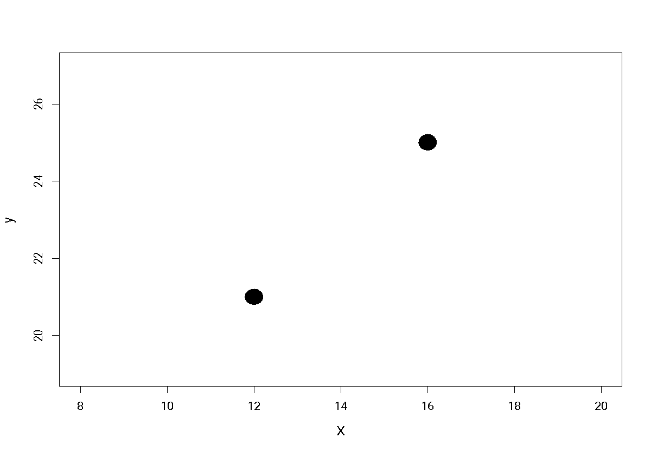
Basic concepts: Regression
80
60
40
20
[ave. y given X = 16]
y
[ave. y given X = 12]
8 10 12 14 16 18
X

Slide 41
Basic concepts: Regression
Regression is concerned with modelling this relationship, i.e. how the ave. y changes as a function of X
We write this as:
[ave. y given X] = f(X)
f(X) is called the regression function and inferring it is the primary goal in regression problems

Slide 42
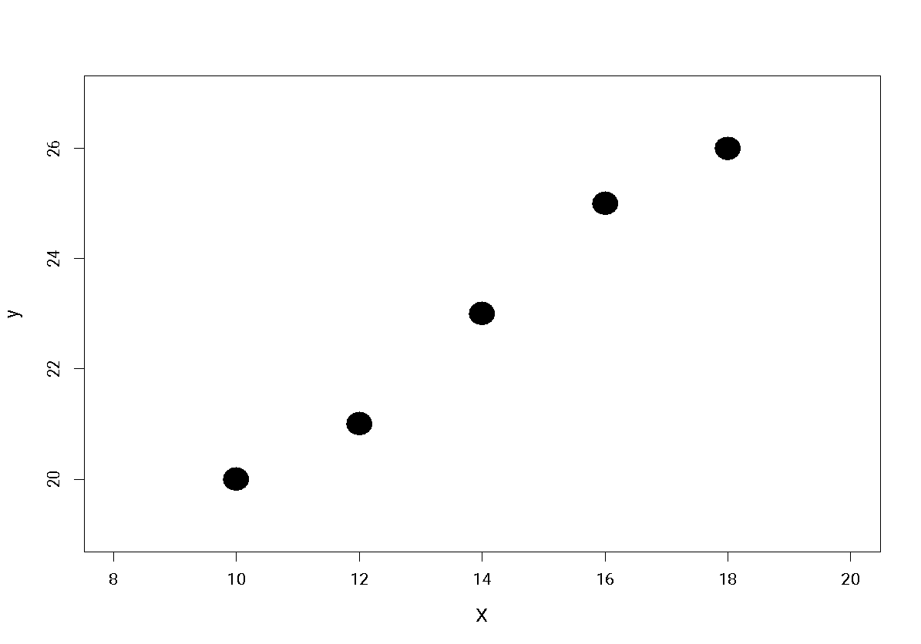
Basic concepts: Regression
80
60
40
20
y
8 10 12 14 16 18 20
X

Slide 43
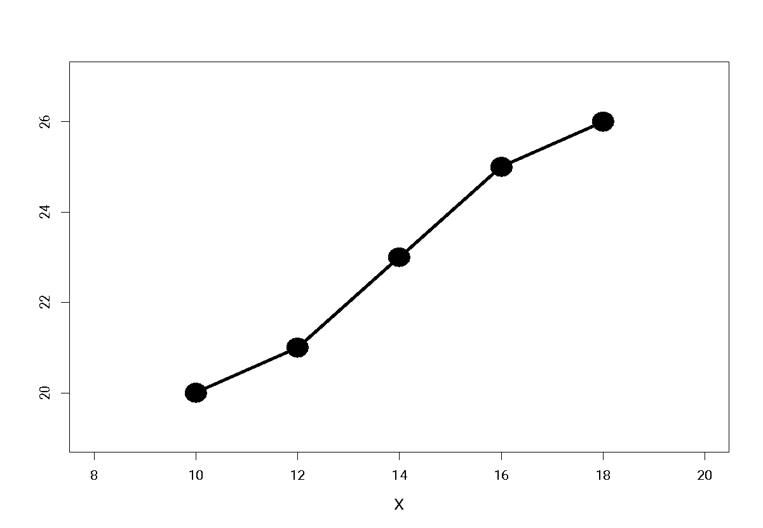
Basic concepts: Regression
80
60
40
20
y
8 10 12 14 16 18 20
X

Slide 44
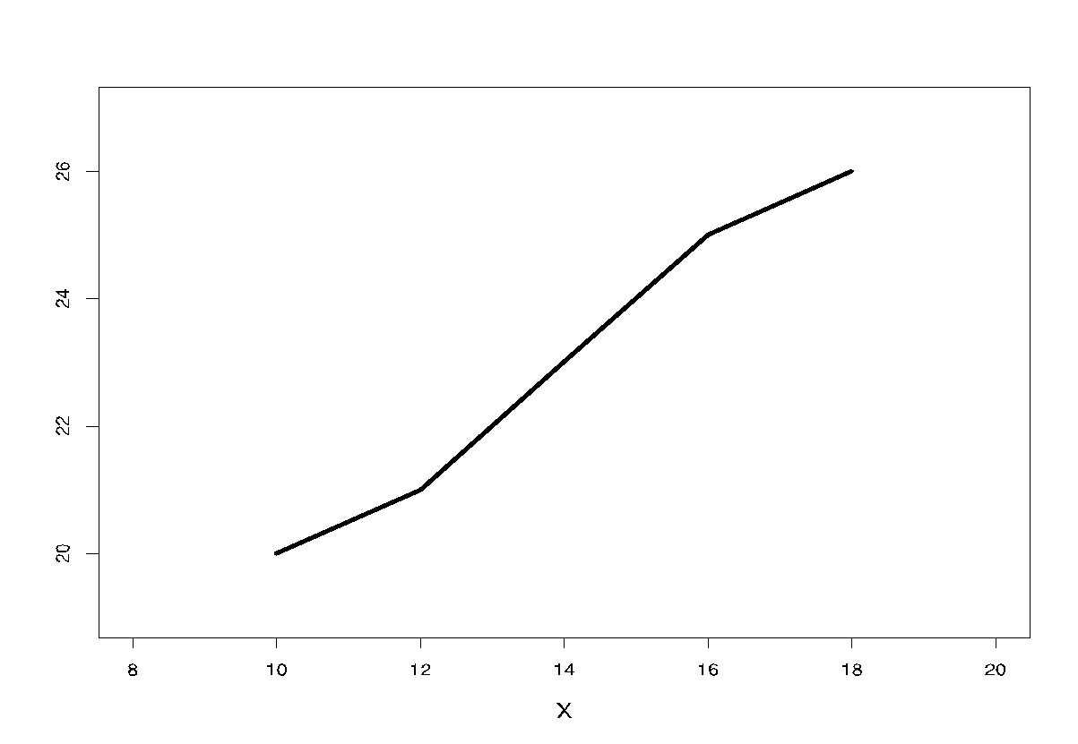
Basic concepts: Regression
80
60
40
20
f(X)
The regression function!
f(X) = [ave. y given X]
y
8 10 12 14 16 18 20
X

Slide 45
Agenda
Overview of Machine Learning
What is ML
Types of ML
Supervised Learning
Regression
Classification
ML Algorithms
Model Selection
Linear Regression
Logistic Regression
k-Nearest Neighbours
Homework

Slide 46
Basic concepts: Classification
In classification, the target variable y takes on a discrete set of values
The simplest kind is binary, where y = 0 or y = 1
1 and 0 are referred to as classes
A classification problem with more than one class is referred to as a multiclass problem

Slide 47
Basic concepts: Classification
Suppose that 10 individuals with X = 16 years of education apply for jobs as data scientists
Some get the job (y = 1) and some don’t (y = 0)

Slide 48
Basic concepts: Classification
Suppose we observe the following data for y:
What’s a reasonable estimate of the probability that y = 1 given X = 16?
1 0 1 1 0
0 1 1 0 1

Slide 49
Basic concepts: Classification
Suppose we observe the following data for y:
What’s a reasonable estimate of [ave. y given X = 16]?
1 0 1 1 0
0 1 1 0 1

Slide 50
Basic concepts: Classification
It seems reasonable to assume that job applicants with more education (higher values of X) would be more likely to get the job (y = 1)
This means, the probability that y = 1 is a function of X:
P(y = 1|X) = f(X)
f(X) is called the conditional probability function and inferring it is the primary goal in classification problems

Slide 51
Basic concepts: Classification
We use the estimated conditional probability to classify unknown observation as y = 1 or y = 0
If f(X) > 0.5, we classify y as 1
If f(X) < 0.5, we classify y as 0
The values of X such that f(x) = 0.5 define the decision boundary

Slide 52
Basic concepts: Classification
P(y = 1|X) = f(X)
Suppose f(10) = 0.4, f(12) = 0.5 and f(16) = 0.7
An applicant with 16 years of education is more likely to get the job than not (prob = 0.7) so we set y = 1
An applicant with 12 years of education is equally likely to get the job and not, so we can’t decide

Slide 53
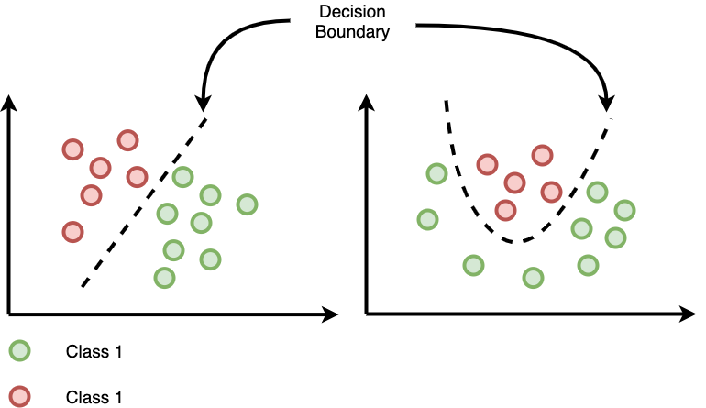
Basic concepts: Classification

Slide 54
Agenda
Overview of Machine Learning
What is ML
Types of ML
Supervised Learning
Regression
Classification
ML Algorithms
Model Selection
Linear Regression
Logistic Regression
k-Nearest Neighbours
Homework

Slide 55
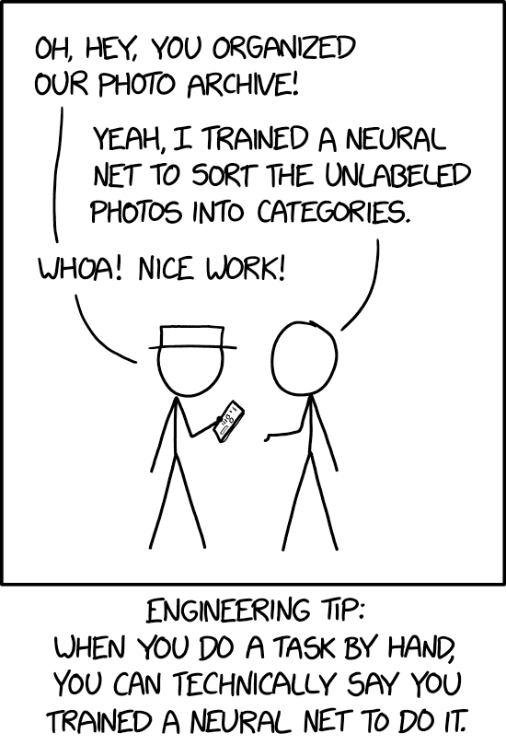
Machine Learning Algorithms

Slide 56
Algorithm vs Model
A ML algorithm is a procedure that is run on data to create a model
Examples: logistic regression, decision tree, support vector machine
A model is the output of a ML algorithm run on data
Model = Algorithm + Training Data

Slide 57
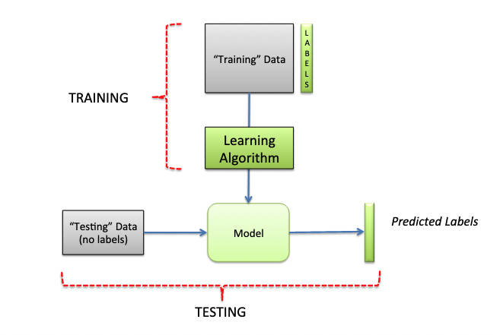
Algorithm vs Model

Slide 58
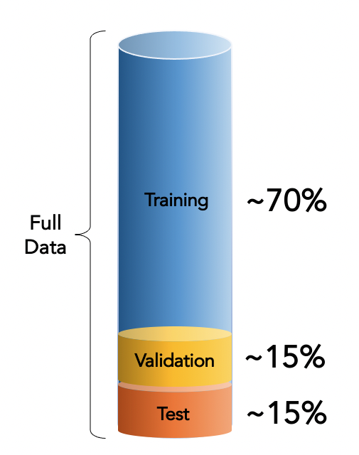
Model Selection: Train/Validation/Test Split
Training set: used to train the model
Validation set: used to select model parameters, perform feature engineering, normalisation, etc
Testing set: completely held out and used only to test the model on unseen data

Slide 59
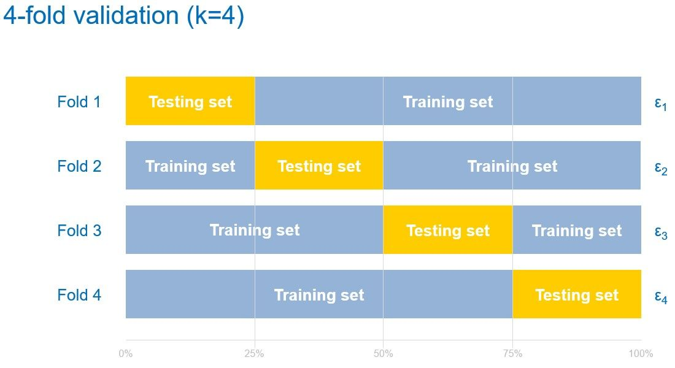
Model Selection: Cross-Validation

Slide 60
Model Selection: Cross-Validation
Leave one out cross-validation: similar to k-fold, where k is equal to the total number of observations
Repeated random sub-sampling: similar to k-fold, but the folds are created by randomly partitioning the data to use as training and testing sets
Stratified approach: ensuring all the training and testing sets have roughly the same class proportions

Slide 61

Model Selection: No Free Lunch
No single ML algorithm is optimal when its performance is averaged across all possible problems
There is no universally superior choice of algorithm
We must therefore compare various model choices and determine which is best for the problem at hand

Slide 62
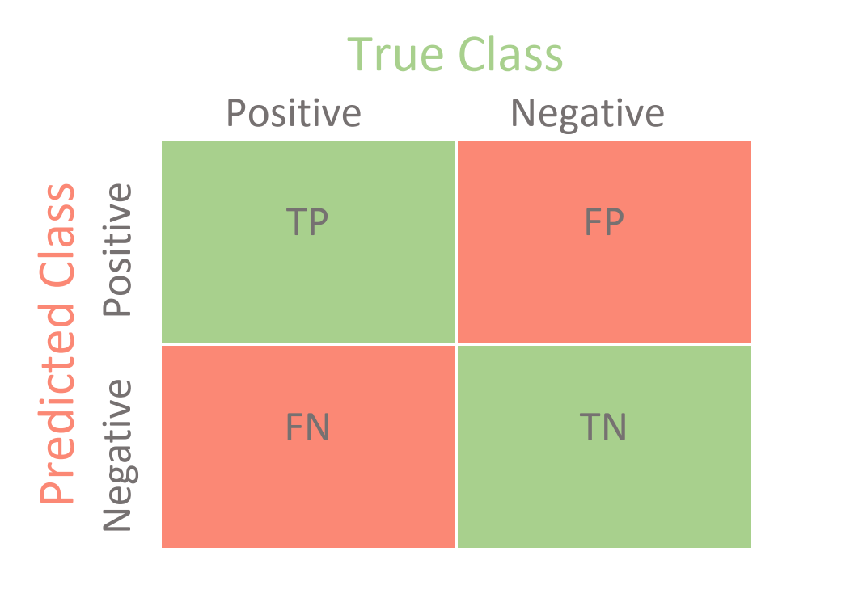
Model Selection: Classification Evaluation Metrics

Slide 63
Model Selection: Classification Evaluation Metrics
Accuracy: proportion of correct predictions
TP + TN
TP + TN + FP + FN

Slide 64
Model Selection: Classification Evaluation Metrics
Precision: proportion of predicted positives that were actually positive
TP
TP + FP

Slide 65
Model Selection: Classification Evaluation Metrics
Recall: proportion of actual positives that were correctly predicted
TP
TP + FN

Slide 66
Model Selection: Classification Evaluation Metrics
F1 score: harmonic mean of precision and recall
Precision * Recall
Precision + Recall
2 *

Slide 67
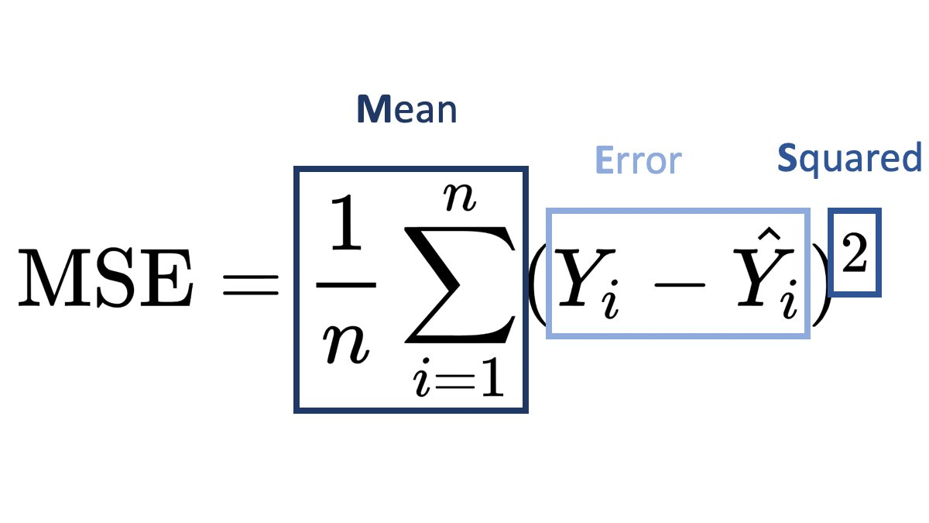
Model Selection: Regression Evaluation Metrics
Mean Squared Error (MSE) is the mean or average of the squared differences between predicted and actual target values in a dataset

Slide 68
Model Selection: Regression Evaluation Metrics
Root MSE is the square root of the MSE.
The units of the RMSE are the same as the target variable, because they are not squared.

Slide 69
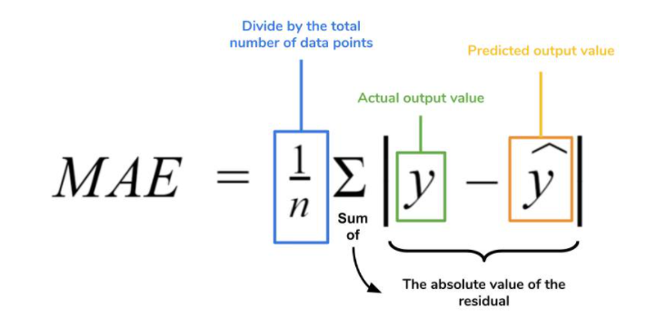
Model Selection: Regression Evaluation Metrics
Mean Absolute Error (MAE) is the average of the absolute error values.
Because the score is always a positive number, changes in the MAE are linear and therefore intuitive.

Slide 70
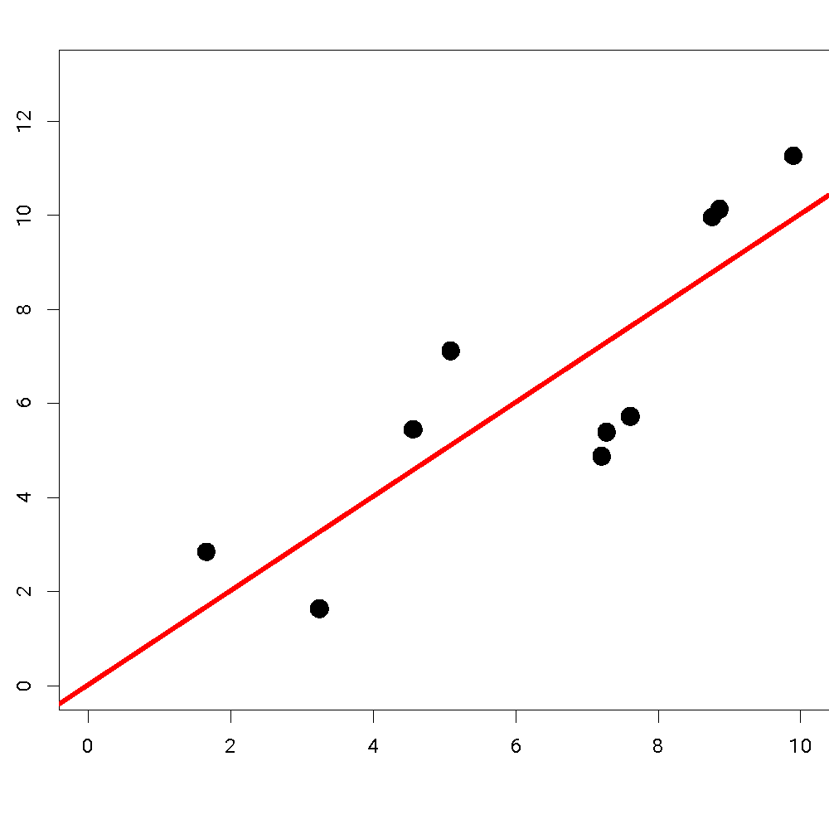
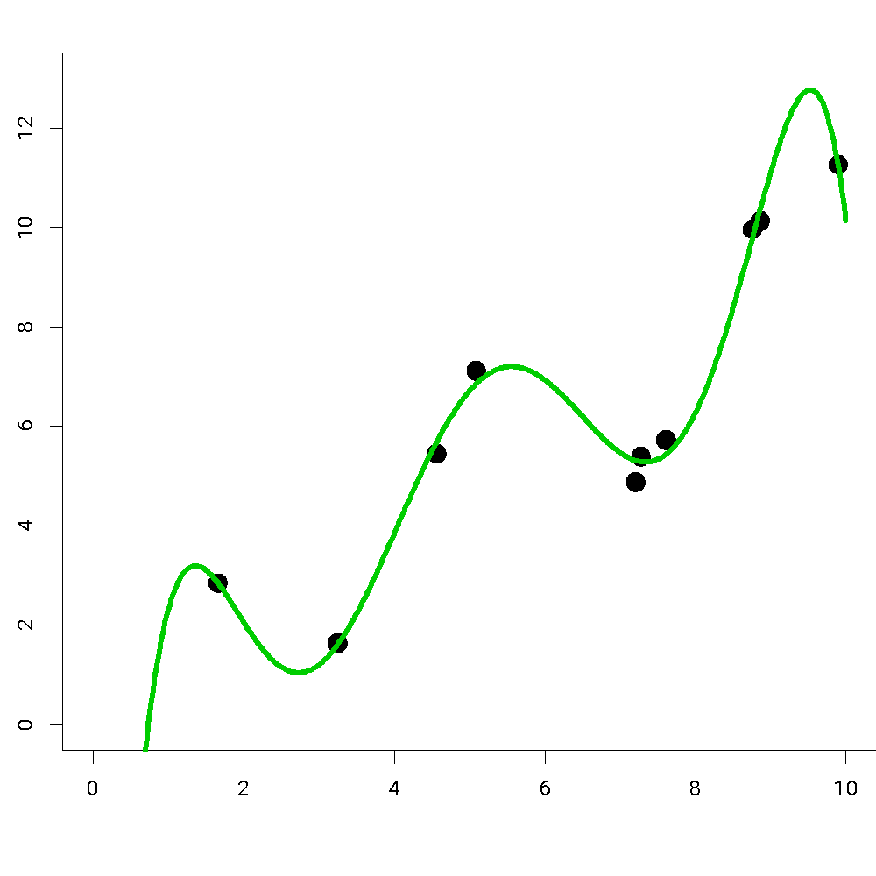
Model Selection: Model Complexity

Slide 71
Model Selection: Model Complexity
If f(X) is too simple, it may not be able to accurately capture the relationship between the features and the target.
This is called underfitting.

Slide 72
Model Selection: Model Complexity
If f(X) is too complex, it may capture patterns that are specific to the training data, but fail to generalise to unseen (testing) data.
This is called overfitting.

Slide 73
Model Selection: The Bias-Variance Tradeoff
Bias: the difference between the model’s predicted value (ŷ) and the actual value (y). An error from erroneous assumptions in the algorithm.
High bias = underfitting

Slide 74
Model Selection: The Bias-Variance Tradeoff
Variance: the variability of the predicted value for a given observation. An error from sensitivity to small fluctuations in the training set.
High variance = overfitting

Slide 75
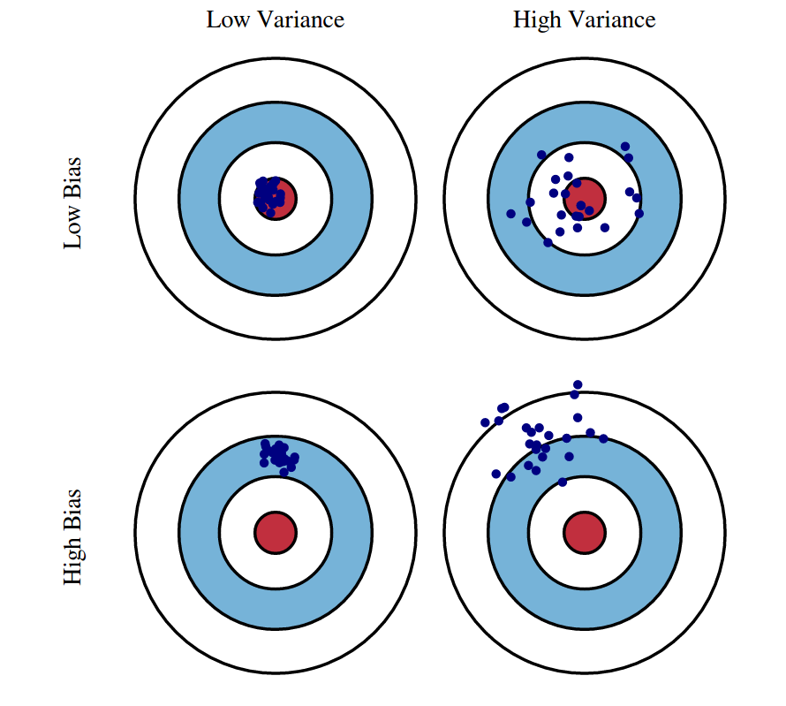
Model Selection: The Bias-Variance Tradeoff

Slide 76
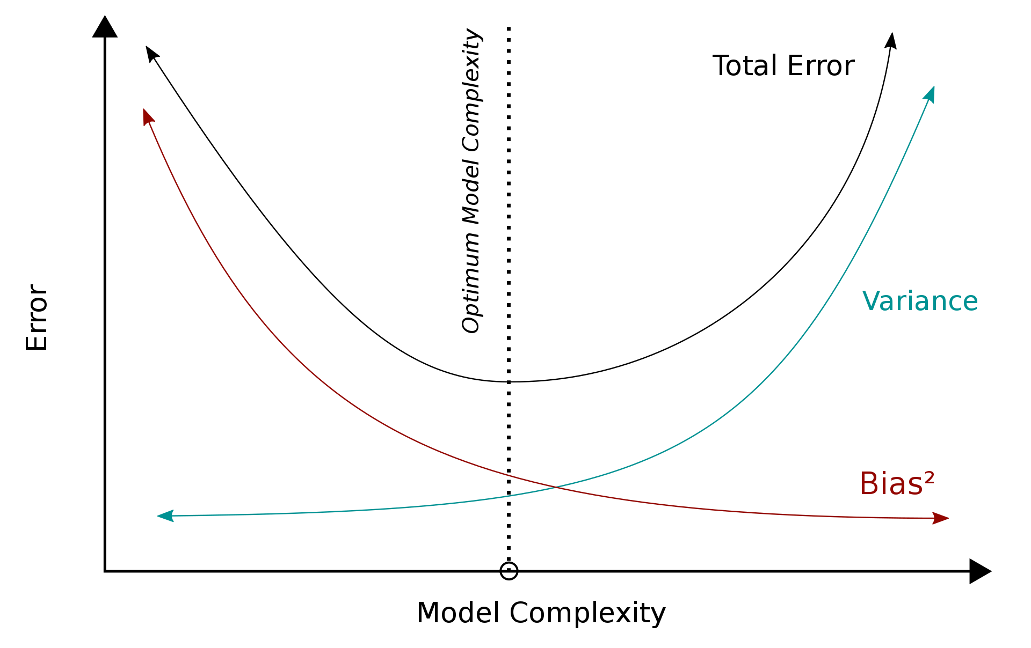
Model Selection: The Bias-Variance Tradeoff

Slide 77


Slide 78
Agenda
Overview of Machine Learning
What is ML
Types of ML
Supervised Learning
Regression
Classification
ML Algorithms
Model Selection
Linear Regression
Logistic Regression
k-Nearest Neighbours
Homework

Slide 79
Regression: A numerical outcome such as stock returns or number of sales
Predict a numerical variable
c

Slide 80
Basic concepts: Regression
Regression is concerned with modelling this relationship, i.e. how the ave. y changes as a function of X
We write this as:
[ave. y given X] = f(X)
f(X) is called the regression function and inferring it is the primary goal in regression problems

Slide 81
Linear Regression: The Equation
Linear regression assumes that the average value of y is a linear function of the features X₁, X₂, X₃ ... X_{n}
Recall the equation of a line:
y = mx + c
f(X) = c + mx
where m is the gradient/slope and c is the y-intercept

Slide 82
Linear Regression: The Equation
For linear regression, this can be written as
f(X) = θ₀ + θ₁X₁ (one feature)
f(X) = θ₀ + θ₁X₁ + θ₂X₂ + … + θ_{n}X_{n} (many features)
where θ₀ ,θ₁,θ₂ are the parameters
To find the best parameters, we need to find which ones best minimize a loss function

Slide 83
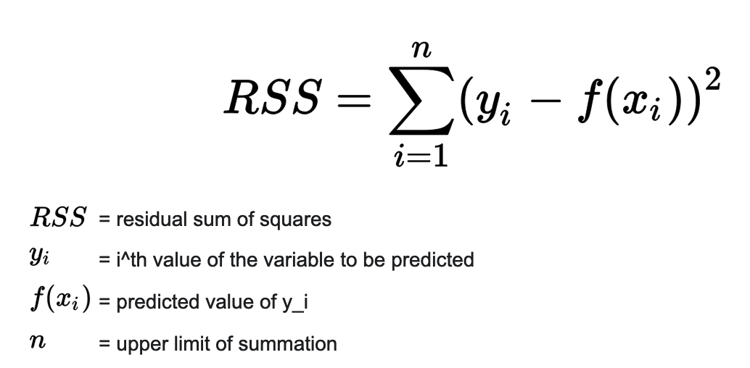
Linear Regression: Loss Function
The most common loss function is the residual sum of squares (RSS) function

Slide 84
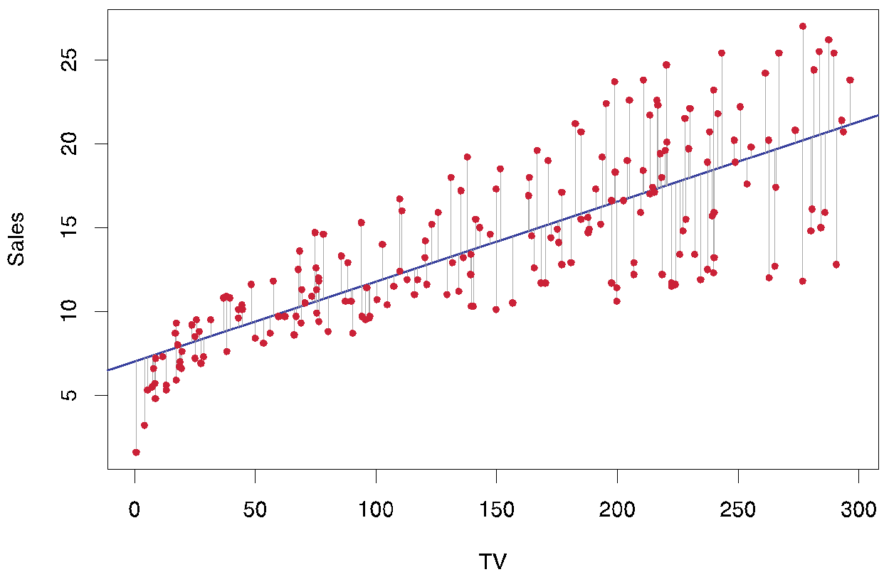
Linear Regression: Minimizing the loss function
We choose parameter values that minimize the squared vertical distances between the points and the line

Slide 85
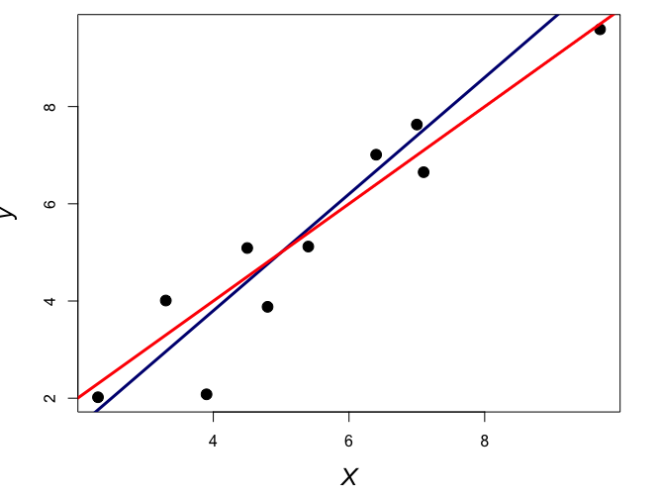
Linear Regression: Minimizing the loss function
θ₀ = -1
θ₁= 1.2
Loss = 7.13
We choose parameter values that minimize the squared vertical distances between the points and the line
This is the lowest loss
θ₀ = 0
θ₁= 1
Loss = 6.15

Slide 86


Slide 87
Agenda
Overview of Machine Learning
What is ML
Types of ML
Supervised Learning
Regression
Classification
ML Algorithms
Model Selection
Linear Regression
Logistic Regression
k-Nearest Neighbours
Homework

Slide 88
Classification: A categorical outcome such as profit or loss, cat or dog, etc.
Predict a categorical variable
c

Slide 89
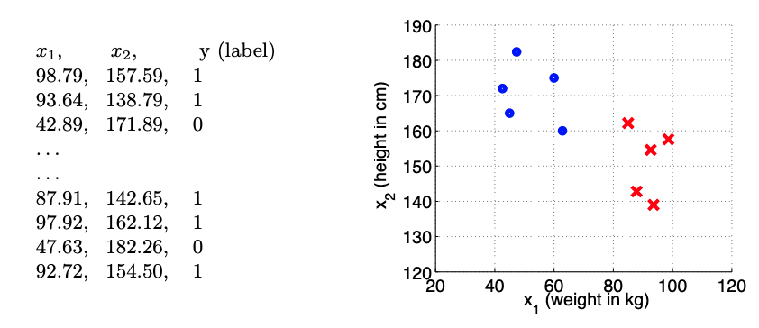
Logistic Regression: The Rugby-Ballet Problem

Slide 90
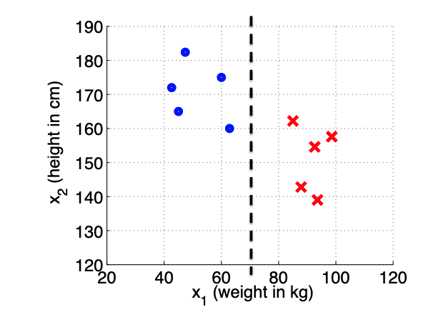
Logistic Regression: The Rugby-Ballet Problem
Decision rule:
if X₁ > 70 then ŷ = 1 else ŷ = 0

Slide 91
Logistic Regression: The Rugby-Ballet Problem
Function:
f(X) = (X₁ - t) where t = 70
Decision rule:
if f(X) > 0 then ŷ = 1 else ŷ = 0

Slide 92
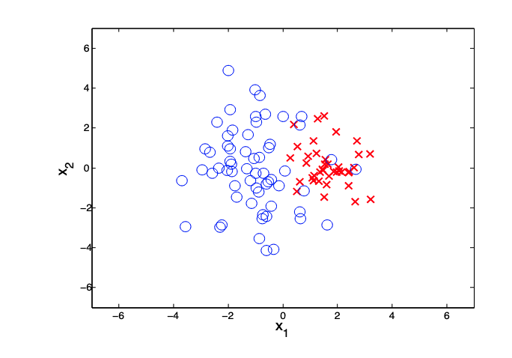
Logistic Regression: Non-Linearly Separable Problems
What is the probability that a given observation is in one class versus another?

Slide 93
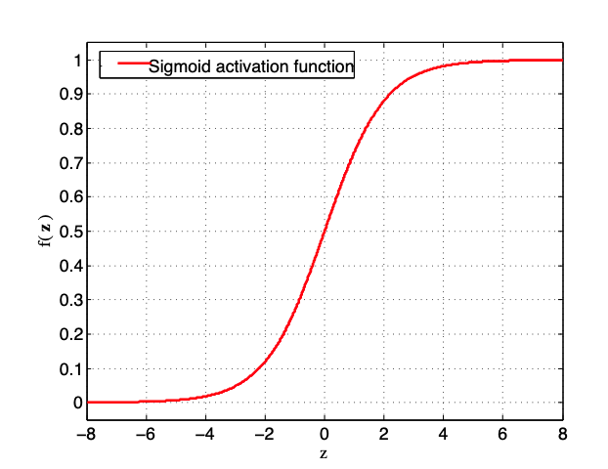
Logistic Regression: Sigmoid Function
New function: the sigmoid function, where the output is a probability in the range of [0,1]
New decision rule:
if f(X) > 0.5 then ŷ = 1 else ŷ = 0

Slide 94
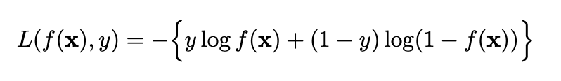
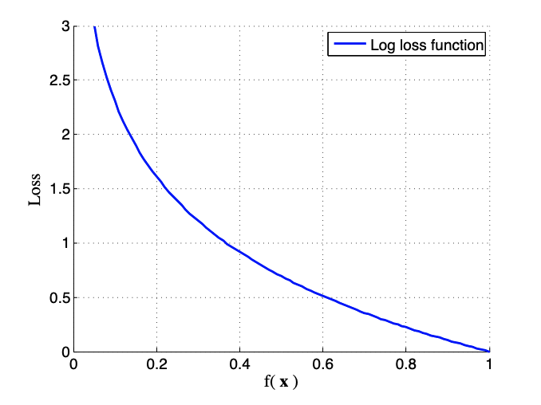
Logistic Regression: Log Loss Function
a.k.a cross-entropy loss function
Graph shows the function for y = 1

Slide 96
Agenda
Overview of Machine Learning
What is ML
Types of ML
Supervised Learning
Regression
Classification
ML Algorithms
Model Selection
Linear Regression
Logistic Regression
k-Nearest Neighbours
Homework

Slide 97
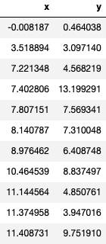
k-Nearest Neighbours: Regression
Consider a simple dataset with a single feature X and a numerical outcome y.
For k=3, the kNN prediction for a new observation X₀ = 8 would be the average of the y values for the 3 observations with X values closest to 8
Closest X values to X₀ = 8

Slide 98
k-Nearest Neighbours: Regression
Closest X values to X₀ = 8
13.2 + 7.6 + 7.3
3
ŷ = 9.36
ŷ =
= 9.36

Slide 99
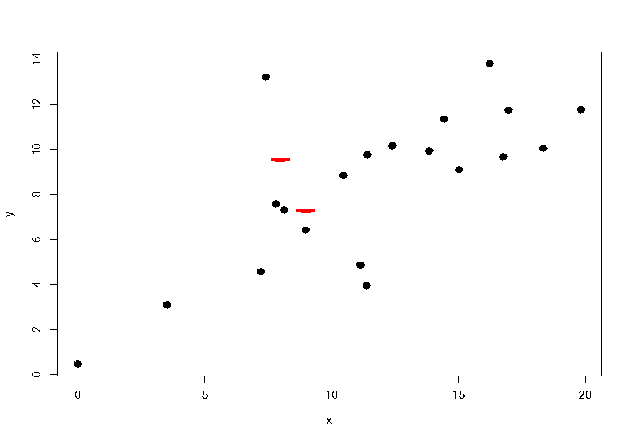
k-Nearest Neighbours: Regression

Slide 100
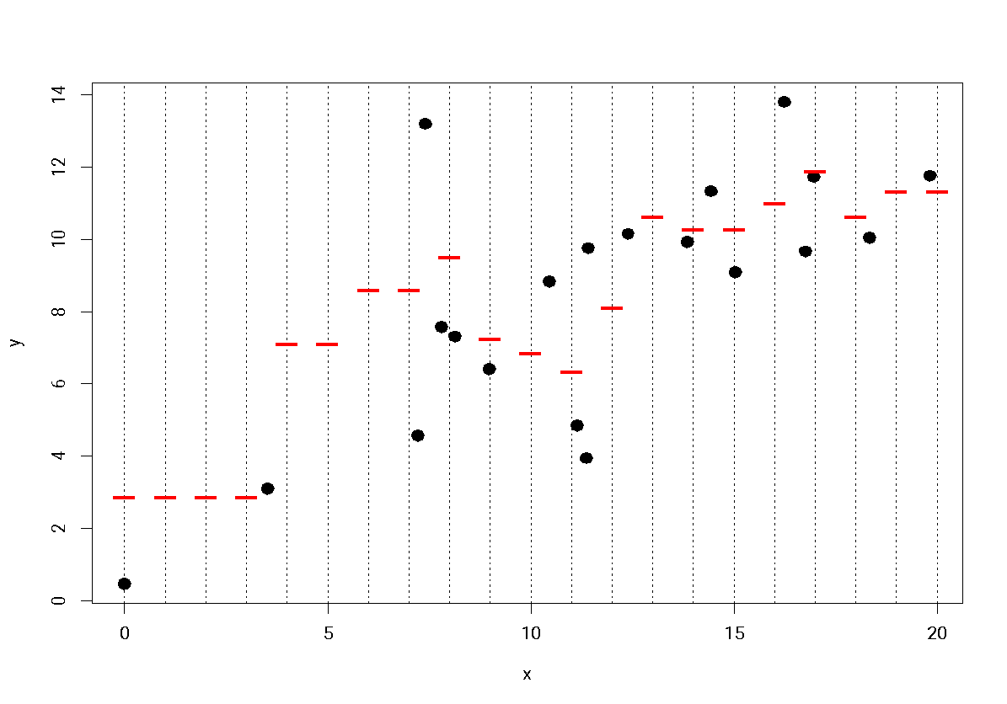
k-Nearest Neighbours: Regression

Slide 101
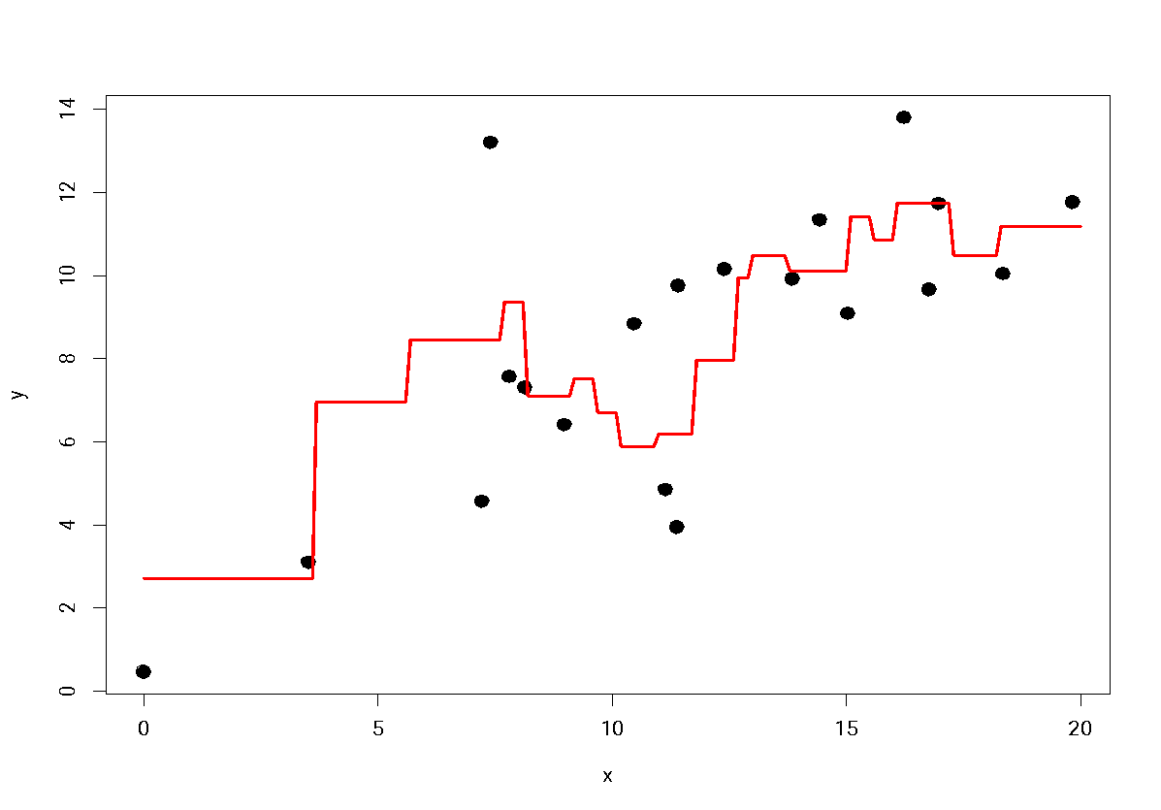
k-Nearest Neighbours: Regression
The kNN regression line with k = 3

Slide 102
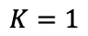
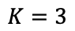
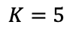
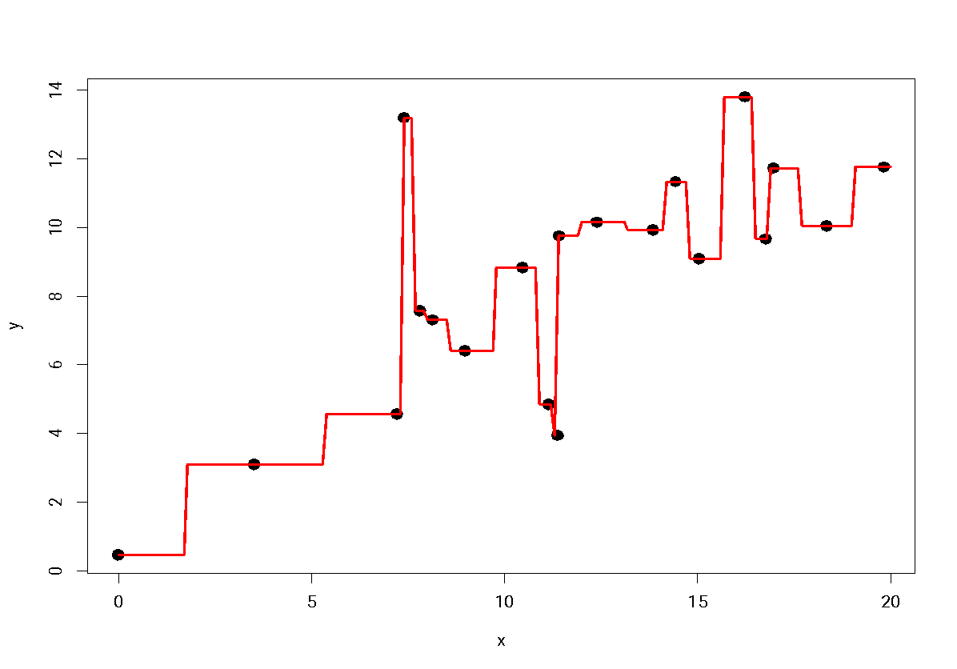
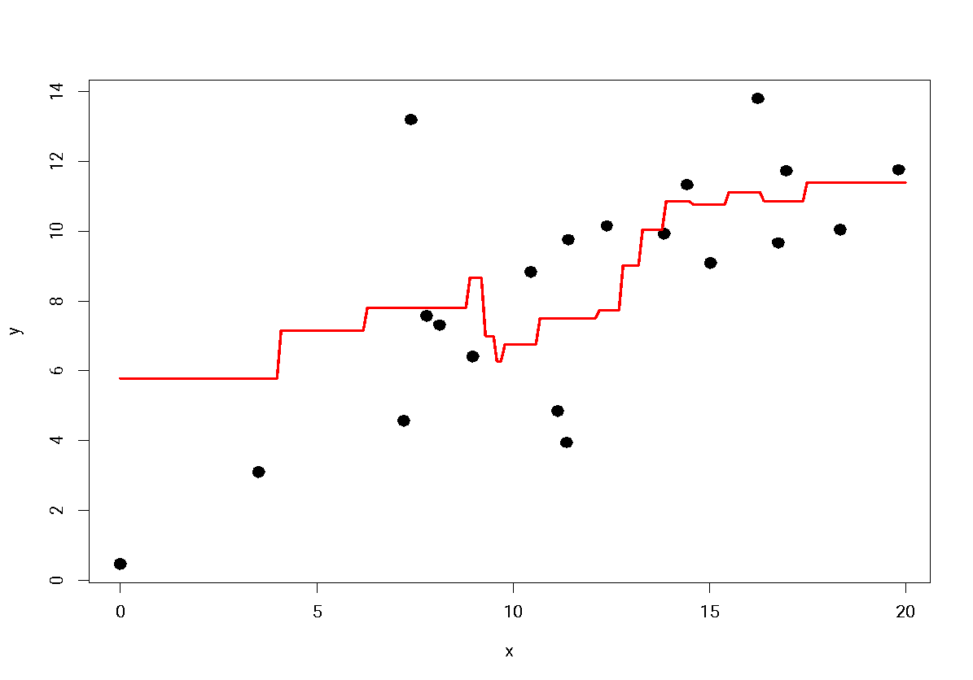
k-Nearest Neighbours: The influence of k
Less bias
More sampling variability
More bias
Less sampling variability

Slide 103
k-Nearest Neighbours: Choosing k
For each value of k:
Fit model on training data
Test model on testing data
Compute the evaluation metrics (MSE, RMSE, MAE)
See which value of k has the least error

Slide 104
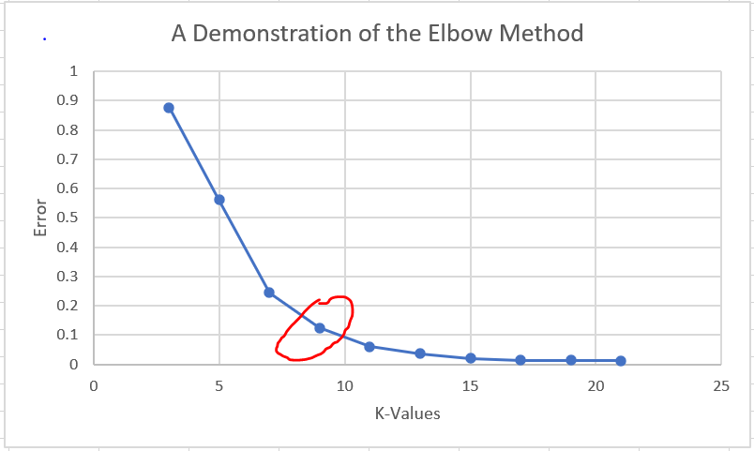
k-Nearest Neighbours: Choosing k

Slide 105
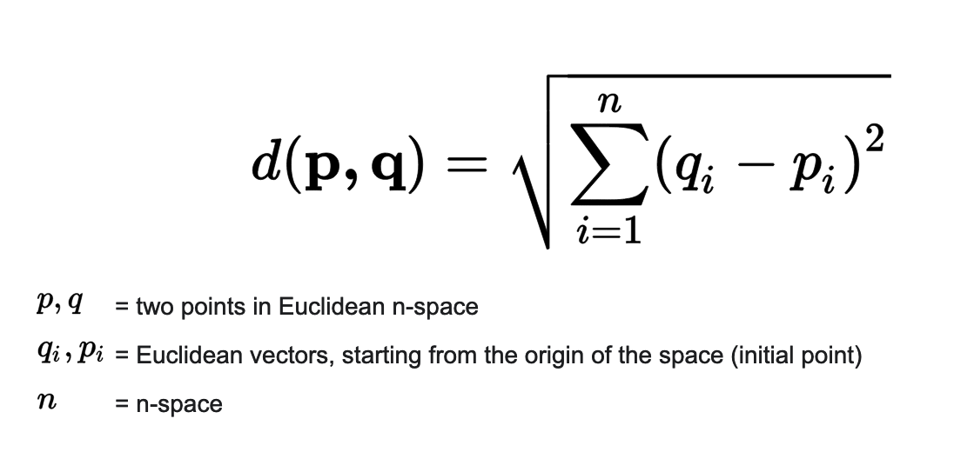
k-Nearest Neighbours: Computing distance
Euclidean distance for numerical values

Slide 107
Agenda
Overview of Machine Learning
What is ML
Types of ML
Supervised Learning
Regression
Classification
ML Algorithms
Model Selection
Linear Regression
Logistic Regression
k-Nearest Neighbours
Homework

Slide 108
Homework
Further your understanding:
StatQuest - Linear Regression
StatQuest - Logistic Regression
StatQuest - k-Nearest Neighbours
Practice exercises:
Linear Regression
Logistic Regression
k-Nearest Neighbours
Learn some more algorithms:
StatQuest - k-Means Clustering
StatQuest - Decision Trees

